Slide 1

Rooting ‘Poison’ Victim Machine (VM)
A Local File-Inclusion Exploitation and Privilege Escalation Walkthrough
A Team RamRod Production
Notes:
Ryan

Slide 2

Intro
In this exercise we will be demonstrating the aspects of a penetration test of a box on the Hack The Box website. Through the use of Active and Passive reconnaissance we will gain valuable information to use the tools we have learned through this course and along the way of cracking this box. This is where red turns purple and we use our red team findings to formulate a blue team response to the type of vulnerabilities that were found. Next you will see the first step into “Poison” a Hack The Box machine.
Notes:
Ryan

Slide 3
OpenVPN
There are 2 main routes of getting started on a HackTheBox exercise. You can use a web-based instance of a Parrot Linux VM, through HTB’s Pwnbox feature, or you can use the OpenVPN’s Lab access file to enable your own Guest VM on your system, such as Kali Linux which we will use here.
Select Connect to HTB in the top right corner.
Click Machines and choose OpenVPN in this case.
Choose an appropriate VPN server and download the .ovpn file
You can import the file via Drag n’ Drop to your Guest VM (Kali)
Then you input the following within the same directory or use the path to .ovpn file:
sudo openvpn lab_username.ovpn

Slide 4
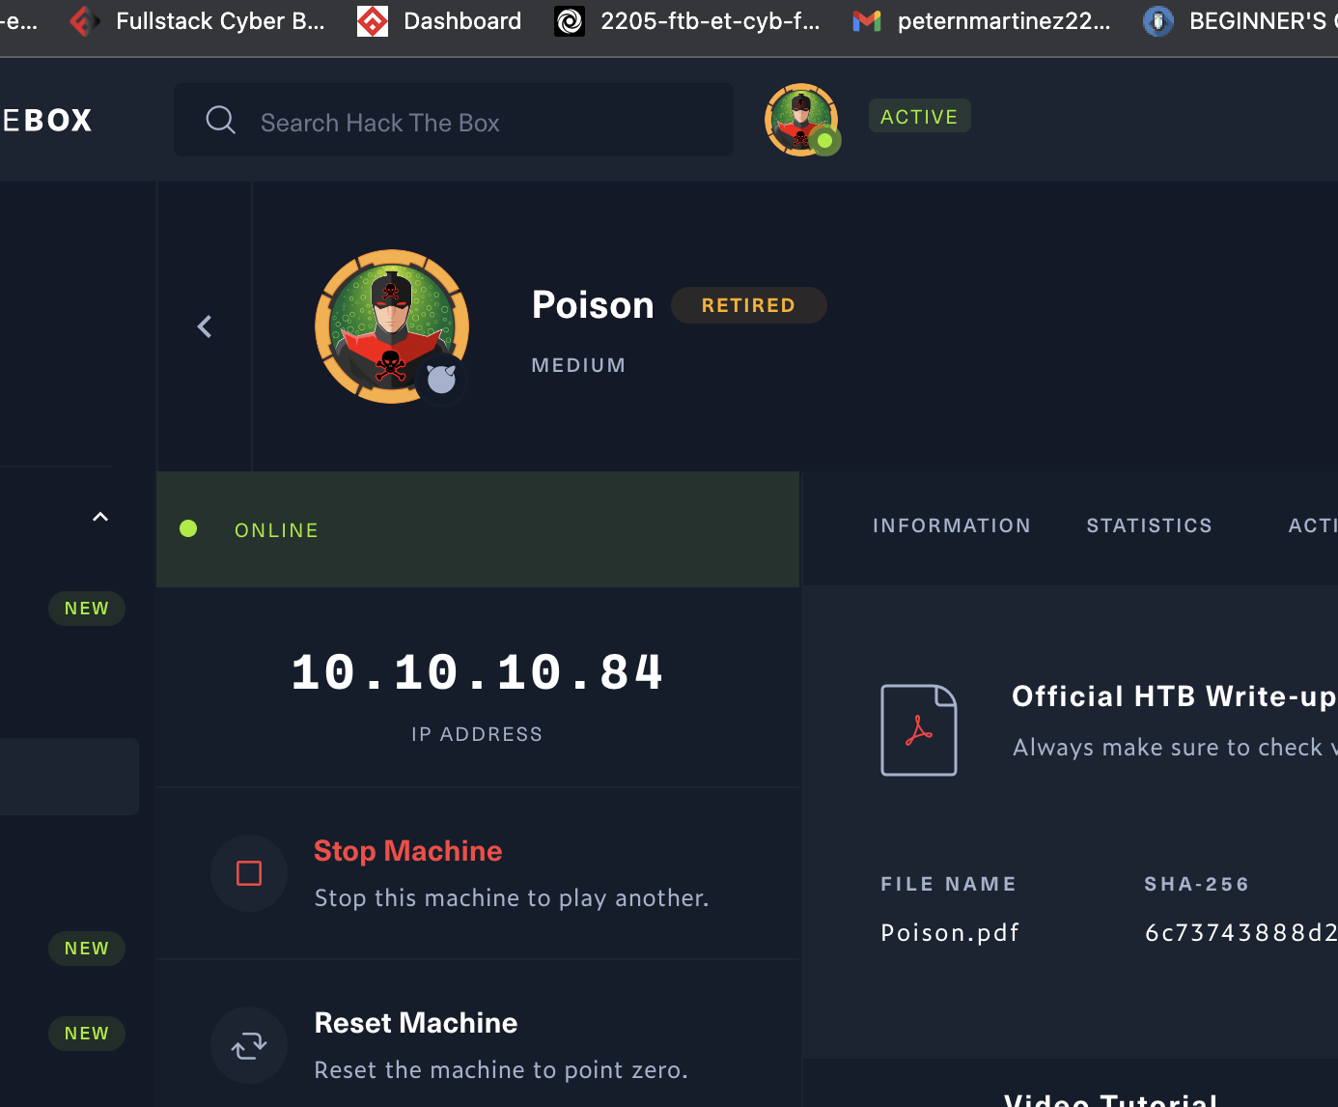
OpenVPN (continued) and Spawn Machine (Poison)
You will see route tunneling occur on the shell, and if you return to the HTB Poison machine page, you will see that a connection attempt is in progress, could take a few minutes and then once the sidebar is Green and says Connected, you can then click on Spawn Machine over on the left side and let that connect. Once connected, you can click on IP address to copy your clipboard:

Slide 5
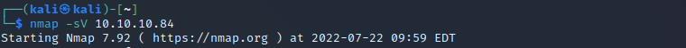
Active Recon: Enumeration - Port Scanning!
Notes:
Peter

Slide 6
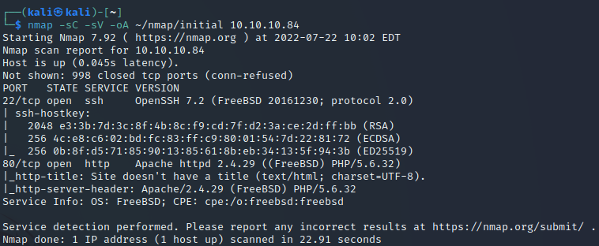
Stronger Scan and Saving Results!
Notes:
peter

Slide 7
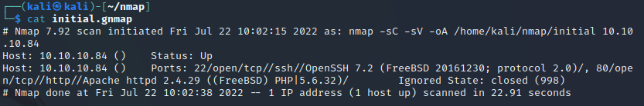

Stronger Scan and Saving Results! (continued)
Notes:
Peter

Slide 8
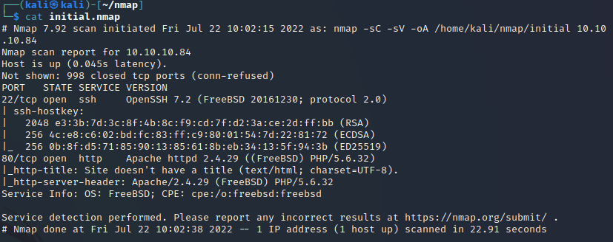
Stronger Scan and Saving Results! (continued)
Notes:
Peter

Slide 9
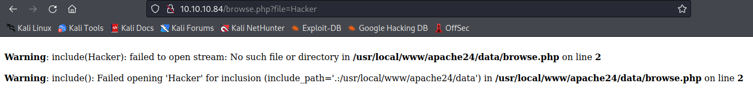
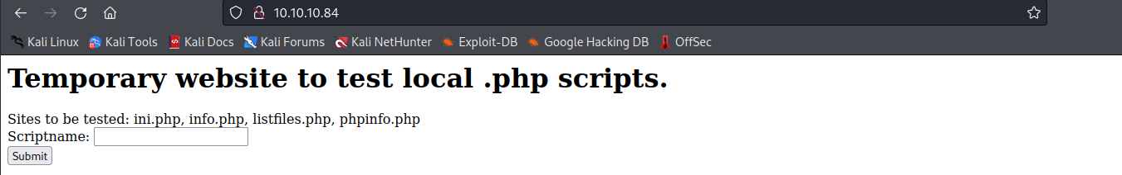
Local File-Inclusion (LFI)
Notes:
Holton

Slide 10
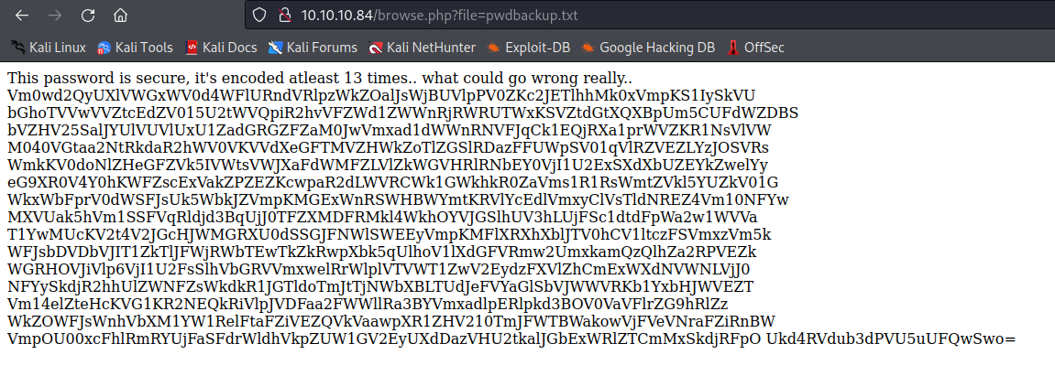
Local File-Inclusion (continued)
Notes:
Holton

Slide 11
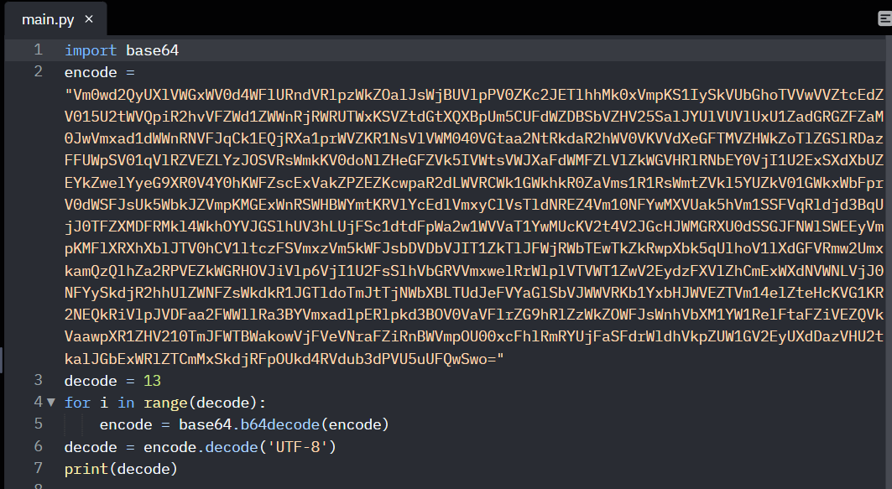

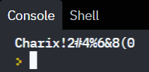
Python!!!
Notes:
Holton

Slide 12
Break Down of the Code
Starting with the import of the base64 infrastructure you give python all the necessary information to manage and read the encoding
Setting the variable: just copy and paste the exact code, in parentheses, behind whatever you want to name your variable (in this case it is encode)
We set the decode variable to 13 so the function runs exactly 13 times
The function is a loop that decodes base64 as many time as it set to in the range
After it runs the given number of times in range it converts the output from Unicode to UTF-8
Then the code prints our result (the password of the unknown user)

Slide 13
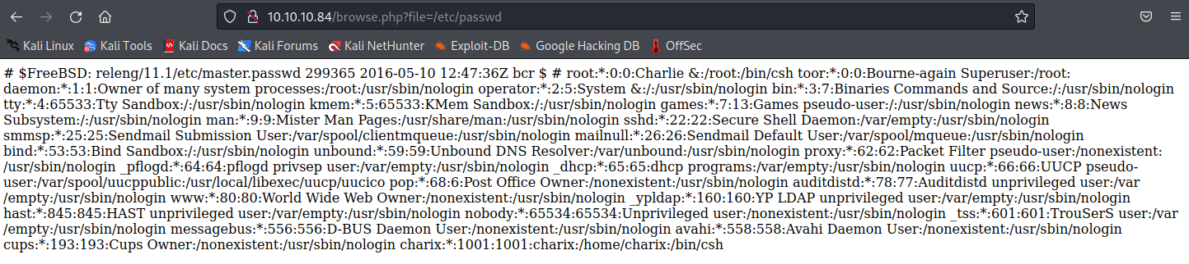
etc/passwd
Notes:
Holton

Slide 14
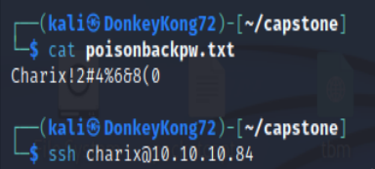
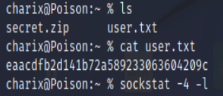
Vital Information
Notes:
Hello my name is Dylan Kahouk
Now that we have the decrypted password with the username we can use SSH. We discovered there is a secret zip file and root has a VNC open on port 5901

Slide 15
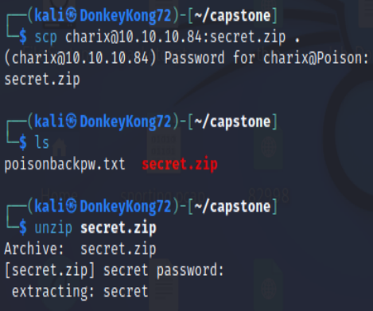

SSH Server Attack
Secure Copy
Unzip Secret.zip file
Bind the local host and open port to the user and IP Address
Notes:
Dylan
We unzip the secret file on our kali by scp, then binded the local host and VNC port to the user and IP

Slide 16

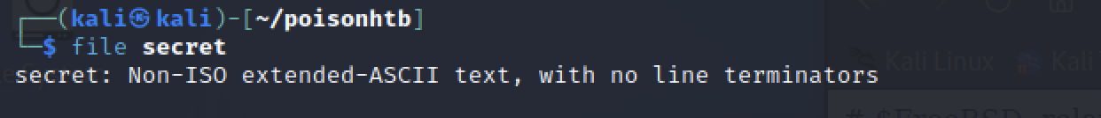
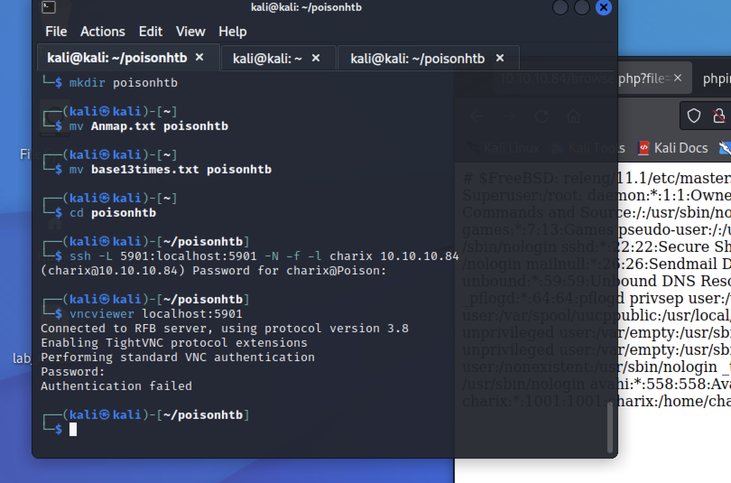
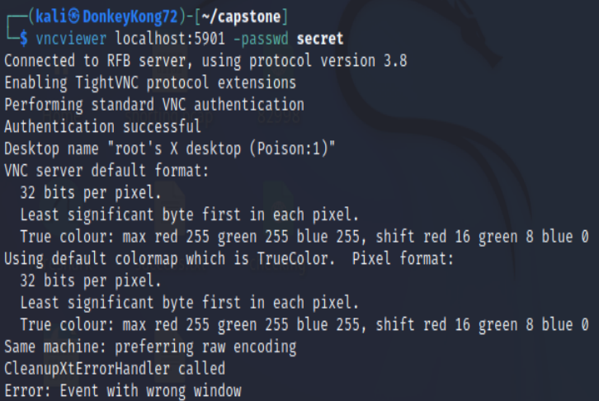
VNC Viewer
Notes:
Dylan
By binding the address, it allowed us to privilege escalate to root on that specific port we used vncviewer to get a rootshell with the secret zip file

Slide 17
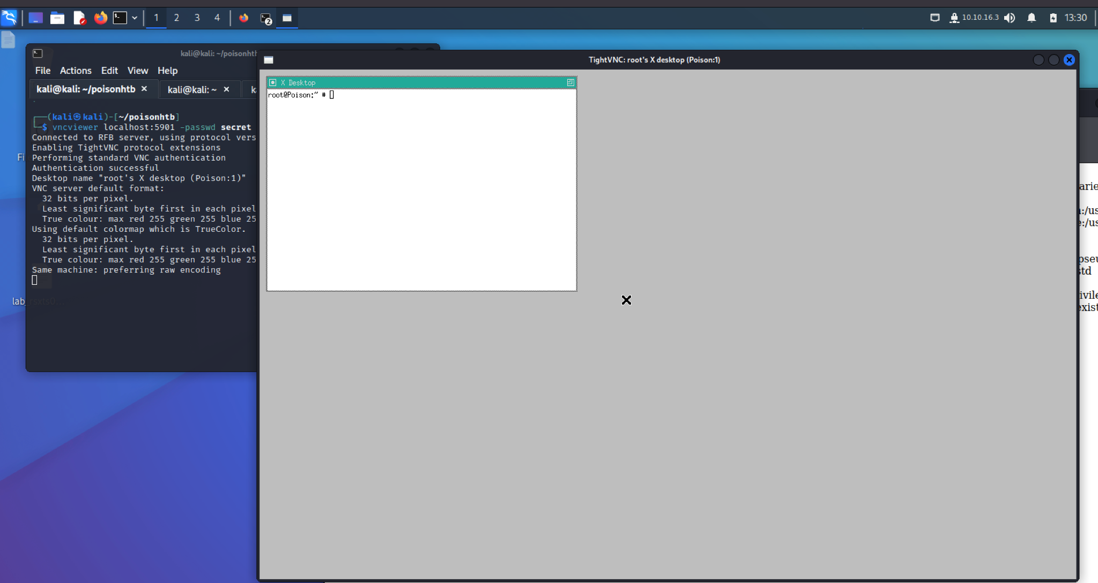
Notes:
Dylan
Once VNCviewer was launched we have full access to the root user and can find the flag.

Slide 18
Key Commands and Options
Ssh <username>@<ip address>
Sockstat -4 -l
-4: Show open IPv4 sockets only
-l: Show listening sockets
Scp <username>@<ip address>:<file> .
Ssh -L <port>:<client>:<port> -N -f -l <user> <ip address>
-L: Specifies that the given port on the localhost is to be forwarded to the given host and port on the remote side
-N: Doesn’t execute remote command, just forwards the port
-f: Request ssh to go to background when all remote port forwards
-l: Specifies the user to log in as on the remote machine
Vncviewer localhost:<port> -passwd <file>

Slide 19

Blue Team Remediation
Local File Inclusion
SSH Server
.PHP Prevention
WAF
Notes:
Ryan

Slide 20
.PHP Prevention(Local File Inclusion)
Authentication Access: even for low level or base line web operations, when hosted on a main machine should require some level of password authentication
Sanitize input fields within server: the url, with no security, will act more as a command line than a website Sanitizing the server will prevent unwanted execution and navigation of input in the server itself
SSL (Secure Socket Layer): the transfer of information from the webhost to the database is crucial and the encryption is just as important

Slide 21
SSH Server Protection
Disable Root Login Over SSH Server: This lowers the vulnerability of having the root password exposed and giving hackers access to all services in the SSH server.
Disable SSH Login Authentication with Password: It is recommended to use ssh public key authentication for remote access to the server. This will better secure brute force attacks on the password.
Limit User Login Access Using SSH: By Default, SSH allows anyone to access remotely. This can be done in ssh_config and setting Allow/Users/DenyUsers
Use Stronger Passwords

Slide 22
WAF (Web Application Firewalls)
The use of a firewall is crucial in many ways. Just as a general rul, this attack could have been almost entirely prevented with the use of a good firewall

Slide 23

Conclusion
Poison, a HackTheBox CTF Target-Practice VM, introduced new and interesting concepts of exploitation, including using SCP to download files from Victim Machine, incorporating VNC Viewer to escalate to root, and the exploitation shows examples of possible threats and vulnerabilities there could be.
Notes:
Ryan

